Slide 1
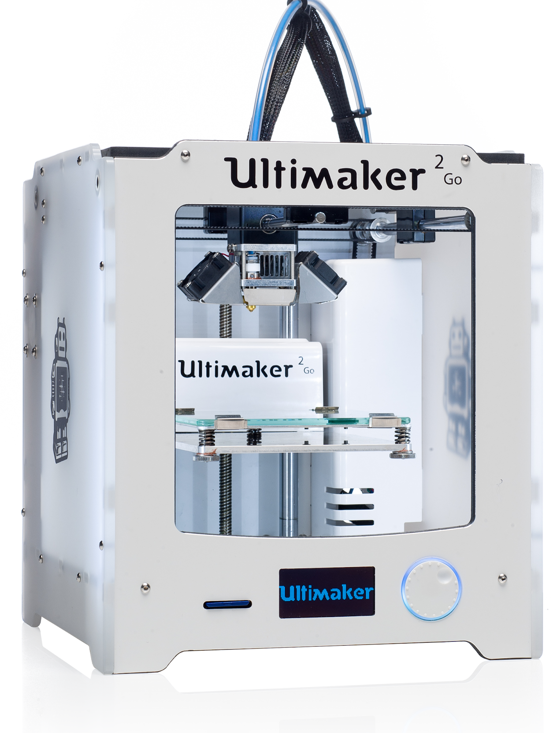



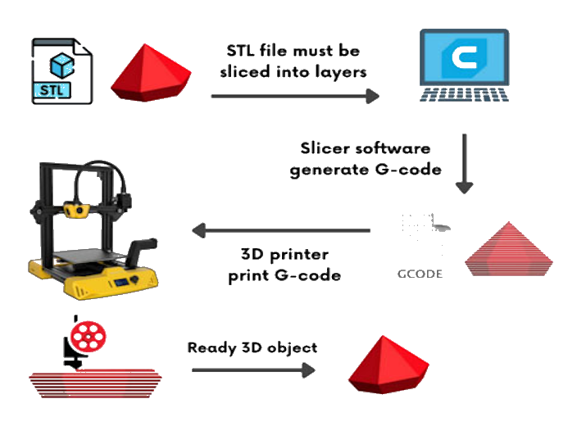
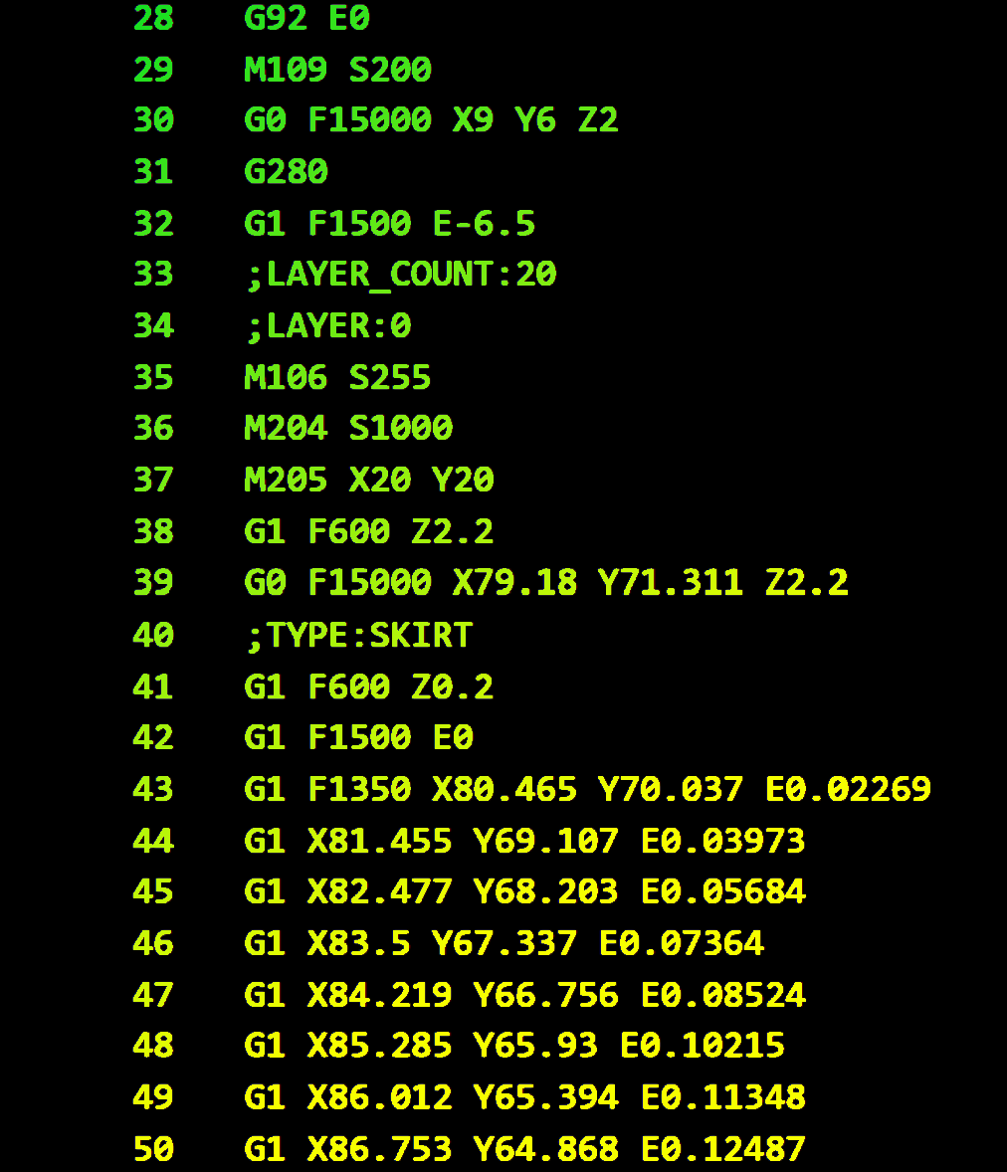
24-318
Machine Learning for CyberSecurity in 3D Printers
Team members: Christ Le, Kevin Phung, Trae Evans, Michael Brown | Faculty adviser: Irfan Ahmed | Sponsor: VCU | Mentor: Hala Ali
Description
Background :
3D printing ( Additive Manufacturing) is a process of creating three-dimensional objects from a digital model by depositing successive layers of material (such as plastic, metal, ceramic, or composite materials) one on top of the other until the object is fully formed.
Steps of 3D Printing:
Design a digital 3D printer file using a Computer-aided design (CAD) software.
Convert the CAD file to STL file.
Slice the STL file into numerical instructions that the 3D printer can understand. This process is called slicing, and resultant instructions are organized in G-Code file.
Execute the G-Code file by the firmware to print the object.
G-Code Data: G-Code are sequences of commands that are received by the firmware of the 3D printer to control the hardware. It's comprised of commands dictating movements, printing speed, fan speed, bed temperature, and extruder temperature..
Information
Problem Statement:
Detection of malicious manipulation within the G-code file before executing it by the 3D printer. Such malicious manipulations can include bed and extruder temperatures.
G-Code Manipulation: The editing of instructions in a G-code file. It is done by adjusting printing parameters which will affect the printer and its print quality.
Industrial Applications:
Healthcare
Aerospace
Manufacturing
Art and Design
Methodology
Downloading STL files, and then convert them to G-code data using slicing software (i.e, Ultimaker Cura)
under varying parameters such as printer profiles, Infill patterns, and other Slicing Settings.
Extraction of Features derived from G-Code files, found based upon G-code commands.
Some Features extracted include some of the following:
M104: Extruder Temperature
M106/M107: Fan ON/OFF
E: Extrusion Amount
F: Extrusion Speed
G10/G11: Extrusion Mode
Current Layer
Command Frequency
Creation of Training and Testing Datasets consisting of CSV files Parsed from G-code, Separated by benign code and malicious code.
Training a classification machine Learning model in order to leverage the machine learning abilities to detect the malicious manipulations.
Results - An application that allows for a user to input a selected G-code file and determine if the file has been modified using the created Machine Learning model if the prediction is above a given value.
Resources
Cura : An Open-Source slicing application for 3D printers, Developed by Ultimaker. Version 5.4.0
Python : A high-level, general purpose programming language. Version 3.11.6
TensorFlow :TensorFlow-based ML framework for computer vision and natural language process tasks.
Version v2.16.1

